Slide 1


DYNAMIC QR-CODE GENERATOR
SUBMITTED BY
PREETHI S (621718104025)
PRIYA S (621718104026)
PONMANI M (621718104023)
PRADEEP M (621718104024)

Slide 2
WHAT IS BARCODE?
A barcode, consisting of bars and spaces, is a machine-readable representation of numerals and characters.
Today, stripes as shown below on packages of products sold at supermarkets, convenience stores and other stores are ubiquitous.
These are barcodes. A barcode consists of bars and spaces of varying width that can be read with an optical barcode scanner.

Slide 3
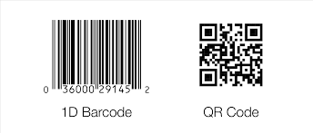
DIFFERENCE BETWEEN BARCODE AND QR-CODE

Slide 4
WHY WE USE QR-CODE INSTEAD OF BARCODE?
QR codes can be smaller - a QR code can be up to 10 times smaller than a bar code and still readable.
So you can print smaller labels that carry more information. QR codes are easier to read - to read a barcode you have aim the scanner in line with the code, while a QR code can be read from any angle.

Slide 5
What are QR Codes?
QR Codes (Quick Response Codes) are 2D barcodes that are readable by smartphones using the devices native camera or a QR code reader app.
QR codes placed in ads, direct mail, retail displays or signage can launch URLs, mobile-friendly landing pages, profiles, initiate phone calls, initiate app downloads and more.

Slide 6
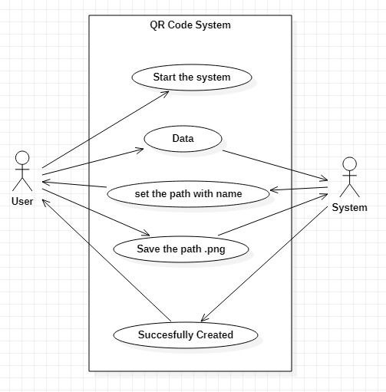
USECASE DIAGRAM

Slide 7
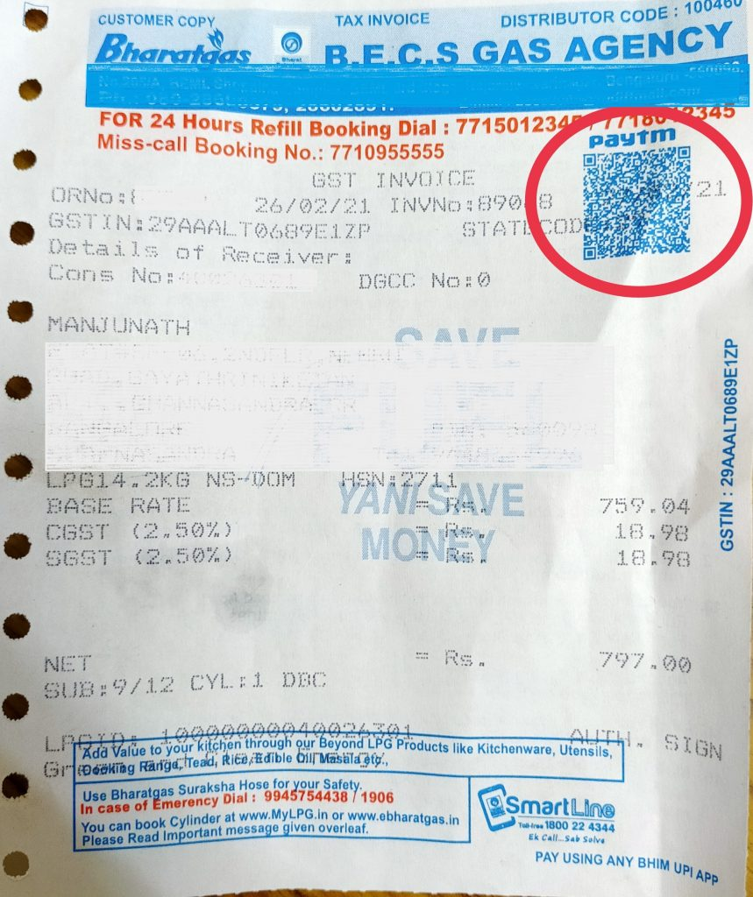
Dynamic QR Code Management
Create QR codes with our QR Code Generator and get the most advanced design, management and tracking available. Personalize your QR code with custom colors, patterns, background image and brand logo.
NEEDS OF QR CODE

Slide 8
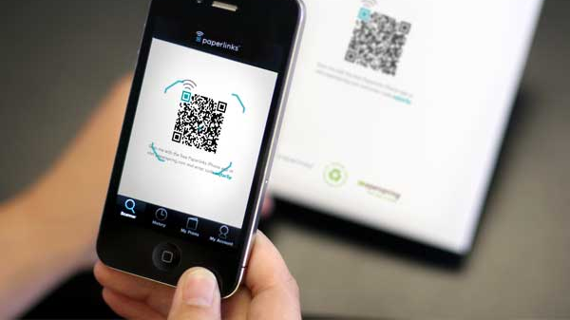
How Does A QR Code Work?
Basically, a QR code works in the same way as a barcode at the supermarket. It is a machine-scannable image that can instantly be read using a Smartphone camera. Every QR code consists of a number of black squares and dots which represent certain pieces of information. When your Smartphone scans this code, it translate that information into something that can be easily understand by humans.
Quite simply, a QR code is an encoded piece of data. The data in a QR code can be alphanumeric, numeric, binary or Kanji (Kanji is a form of Chinese characters that are used in the modern Japanese writing system)

Slide 9
SPECIFICATIONS OF QR-CODE
The customer pays through credit/debit card or through UPI, and the supplier provides a cross-reference of these payment details on the invoice, such as the transaction ID, date, time, amount, and mode of payment.
The customer pays with cash, and the supplier provides a cross-reference of the date and amount details on the invoice.

Slide 10
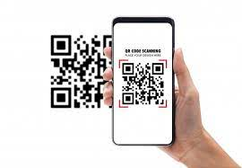
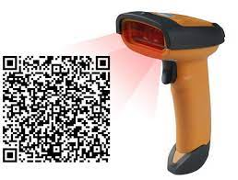
HOW TO USE THIS?

Slide 11
Create dynamic QR codes to manage content on your print materials.
Save Printing Costs
No need to reprint your material when you change the destination URL
Optimize Conversion Rate with Analytics
Dynamic QR codes are trackable. Get analytics on scanning activity
Run Dynamic Campaigns
Run interactive campaigns with dynamic content using a single QR code
Ensure Content is Relevant
Update content with time without changing the QR code to maintain relevancy

Slide 12
System testing
Scan the QR code with multiple devices and apps
Test the QR code with various lighting levels.
Test the QR code at different distances.
Verify the strength of internet and cellular reception in the area where the QR code is placed.

Slide 13

WHAT ARE THE BENEFITS OF QR-CODE?

Slide 14

1. Editable/Modifiable in content even after printing or deployment
QR codes can be edited in data even after users have printed them in different marketing materials or even after distributed online.
With that being said, users can save a large portion of their expenses from re-printing QR codes.

Slide 15
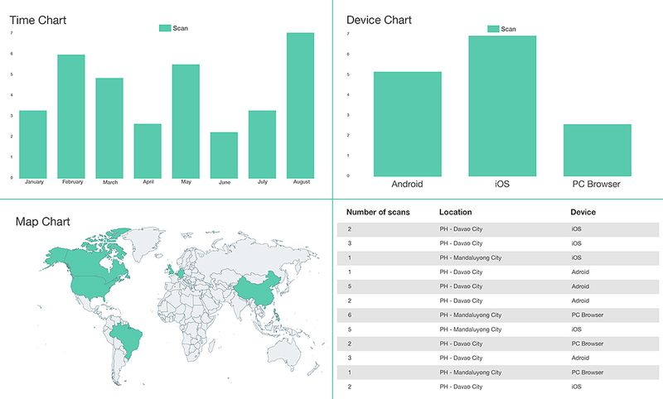
2. QR code scans are trackable
The ability of QR codes to track its QR code scans allows users to understand their QR marketing campaign.
This gives them comprehensive data about the behavior of their target audience and allows users to unlock powerful data statistics to better improve their marketing and a better return of investment!

Slide 16
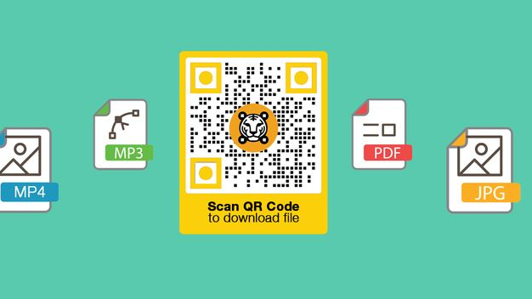
3. Allows for multi-media content
A QR code has many types of solutions, it uses four standardized encoding modes (numeric, alphanumeric, byte/binary, and kanji) to store data efficiently; extensions may also be used.

Slide 17
4. Can Hold More Information
It is impossible to use barcodes for the things that QR codes are doing because of the small information they can hold. While barcodes can only store 25 characters, QR codes can go up to more than 2500.
5. Flexible in size
Barcodes tend to have a much bigger minimum size in order to be scannable. QR codes can get really small, allowing them to be placed on various locations, including the corners of product packaging

Slide 18
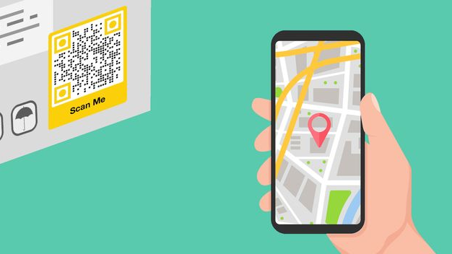
6. The QR code's content is accessible through smartphone devices.
Using barcodes entails putting a lot of effort into scanning the codes themselves. It is because they can only be read in one orientation, unlike QR codes that can be scanned in any orientation.
Thus, providing the audience quick information about a product, service, or item by scanning the QR code.

Slide 19
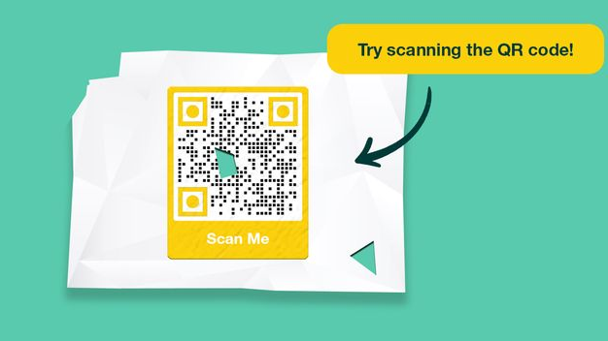
7. Resilient and Reliable
Slight damage to barcodes can easily render them useless. As opposed to QR codes that can receive damage of up to 30% of the image before starting to show scanning errors.

Slide 20
USES OF QR-CODE
Advanced Scan Tracking
Track scans by location, time, operating system, engagement method, and acquisition channel
Visually-appealing Infographics
View visually-appealing audience heatmaps and infographics of your scan data to easily analyze campaigns
Analytics Report and Data Export
Export analytics report in CSV for reporting or further analysis

Slide 21
Advantages of Codes
Once your print items have been distributed, there’s usually no turning back. With Dynamic QR Codes, you still can make changes.
These types of Codes allow you to update their content on the go and see how this impacts your campaign success.
If you want to learn more about Dynamic QR Codes, this guide is the best place to start.

Slide 22
Objectives and goals
Providing smartphone users with information, quickly and simply, is what makes QR Codes and mobile marketing go hand in hand like PB & J.
They enhance your marketing campaigns, allowing you to reach, engage and convert a wider target audience by linking from offline to online platforms.

Slide 23
FEATURE OF QR CODE
QR Code is capable of handling all types of data, such as numeric and alphabetic characters, Kanji, Kana, Hiragana, symbols, binary, and control codes.
Up to 7,089 characters can be encoded in one symbol. A QR Code symbol of this size can encode 300 alphanumeric characters.
QR codes are easy to create and use, and offer a broad array of possibilities for marketers, ranging from online and print advertising to shop window displays and product packaging.

Slide 24
DRAWBACKS OF QR-CODE
Lack of familiarity with the QR code among people.
It requires a phone with a camera which makes it costly for the common users to afford.
Codes dependability on a smartphone. ...
Smartphones used to scan QR codes are often expensive and costly in comparison with simpler phones.

Slide 25


